Slide 1
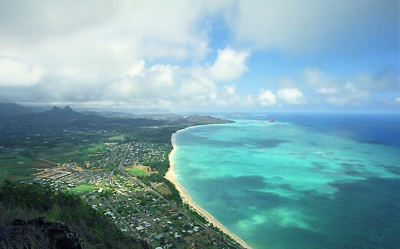
Native Hawaiian
Well Being and the Integration of Cultural Practices to Promote Health
Mike Spencer
Fedele F. Fauri Collegiate Professor
University of Michigan
School of Social Work
Notes:
Suquamish, Duwamish, Nisqually, Snoqualmie, and Muckleshoot tribes

Slide 2
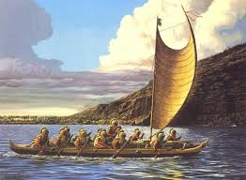
Historical background
Indigenous people of Hawaii—ancestors living in HI prior to 1778
Navigated and settled in HI from Marquesas Islands and Tahiti over 2000 years ago
Developed distinct culture, yet similar to other global indigenous cultures
Population estimates 500,000 to 1 mil.

Slide 3
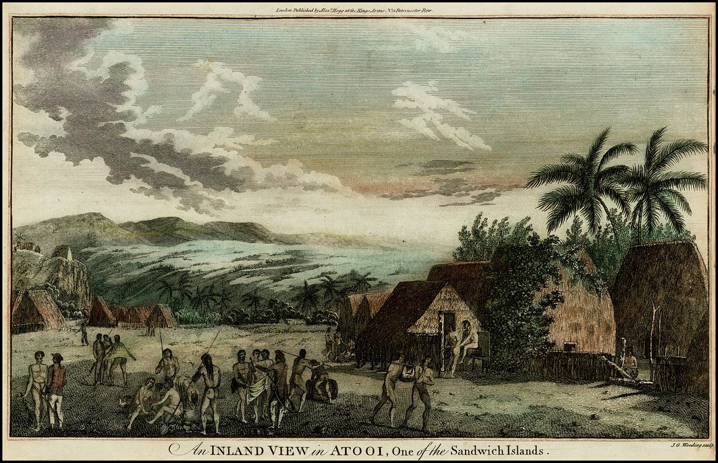
Native Hawaiian People
Dependent upon land, sea, and each other
Described as physically fit, nimble, muscular, and stately individuals
Great respect for all living things, nature not objectified, but personified
Deadly diseases, such as TB, small pox, measles unknown

Slide 4
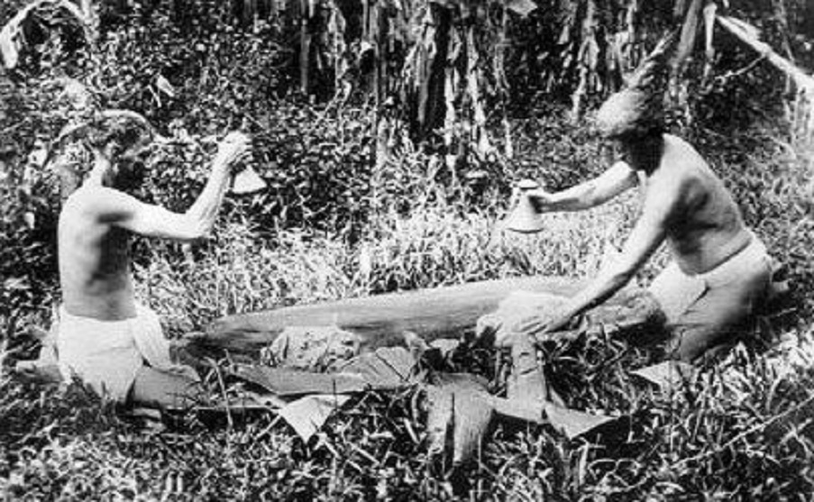
Native Hawaiian Life
‘Ohana—extended family who share common goals, vision, and purpose
  Source of support
  Transmission of culture—oral tradition
Economy based on fair exchange, not profit
Aloha—love, mutual regard, and caring
Lokahi—unity and harmony
  oneness with the self, the family, the community, the land and sea, and the spiritual powers

Slide 5
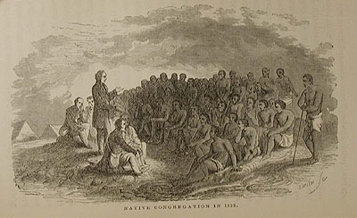
Trauma and Colonialism
Dramatic decline in Native Hawaiian population post-European contact
  1784 estimated 142,000
  1896 first official Census, 39,504
  Causes include warfare, pestilence and disease
Colonialism
  Capitalism—dispossession of land due to land ownership, sandalwood trade, whaling, pineapple, sugar cane plantation
  Christianity--eroded the existing system of moral order, spirituality, and culture
  Eradication of Hawaiian language-1896, banned from schools

Slide 6
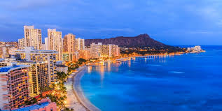
The Invisible Mana’o (Concerns) of Native Hawaiians
Lack of ethnic specific data
  Aggregation of data with Asian and Pacific Islanders
  Numbers are small even when specific data collected.
Problems blurred by import tourist culture
  What you may think is Native Hawaiian is not…
  What could be wrong with living in paradise?
Native Hawaiian population is regional, problems are provincial

Slide 7
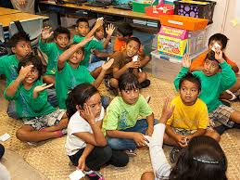
Educational
Well Being
Just more than half graduate from high school, and fewer than 10% go to college
Higher rates of absenteeism, grade retention, score below national and state average on overall academic achievement, reading, math, science, & social studies
16% high school dropout rate (10% HI average)
  Separation of formal education system and Native Hawaiian culture, norms, language, and values (Ogbu, 1992)

Slide 8
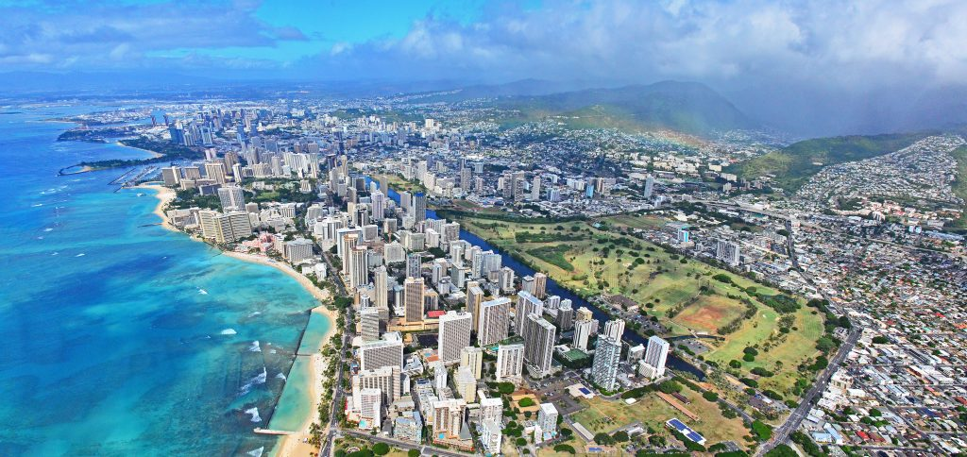
Economic
Well Being
Shift from agriculture to tourist economy, massive land transformation
Occupational ghettoization,” large profits to minority, low paying service jobs to the majority
“One of the highest costs of living in the U.S.
Highest percentage in HI living in poverty
Highest percentage in HI unemployed

Slide 9
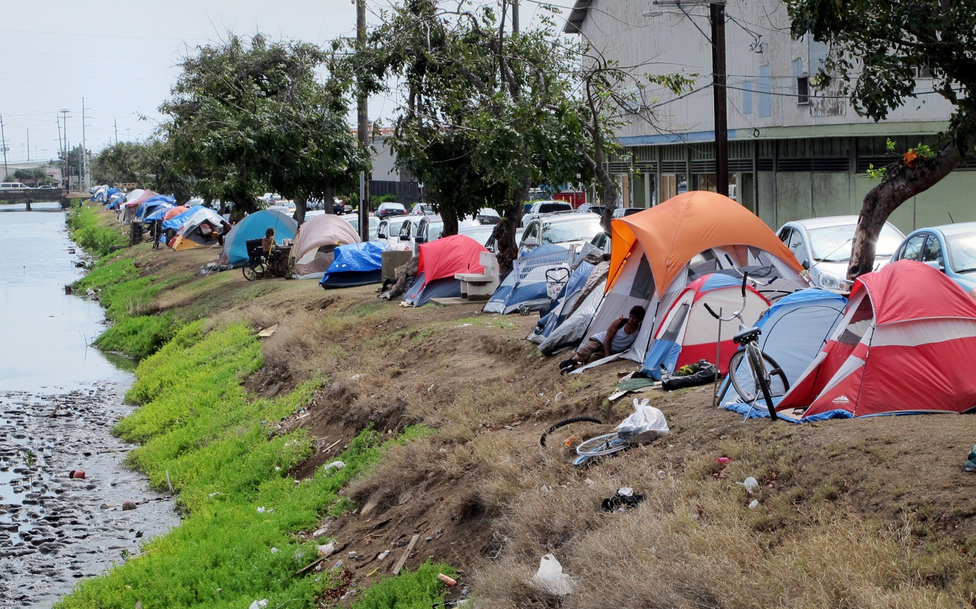
Social
Well Being
Bereavement of the right to self-determination
Loss of culture, land, and resources
28% of homeless population
Native Hawaiians rank highest in child abuse and neglect, placement in correctional facilities, teenage pregnancies, receipt of public assistance
Also rank high in crime rates, and alcohol abuse

Slide 10
Native
Hawaiian Health
Highest rates of mortality, child mortality
Obesity—60%
  Highest rate of CVD
  Second highest cancer mortality rate for all cancers combined
  Diabetes--44% of all cases of diabetes reported in the State
  Asthma rate is more than double the rate of the other racial groups, 35% of all cases
  Native Hawaiians constituted 20% of resident deaths due to HIV infection

Slide 11
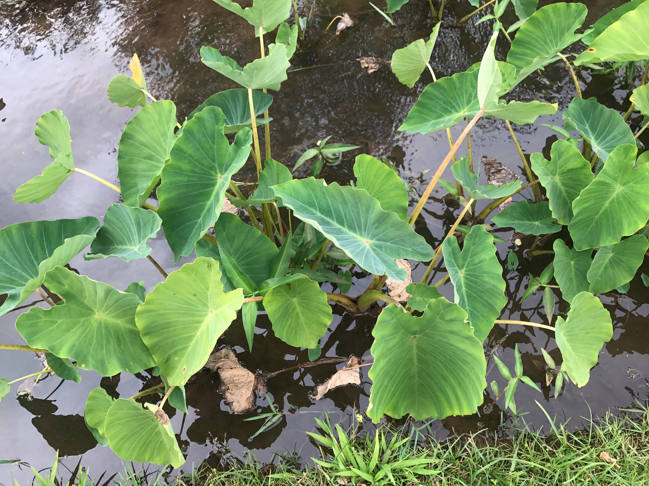
Barriers to Service Use
Accessibility, due to low SES, lack of health insurance, rural and isolated geographic communities
Perception of health care
  Overlook cultural values and practices
  Medical professionals judgmental of patient lifestyles
  Discrimination leads to lack of trust of health care system
  Low number of Native Hawaiian providers
  Patterns of high hospitalization and long-term care, due to lack of health promotion, education, and screening

Slide 12
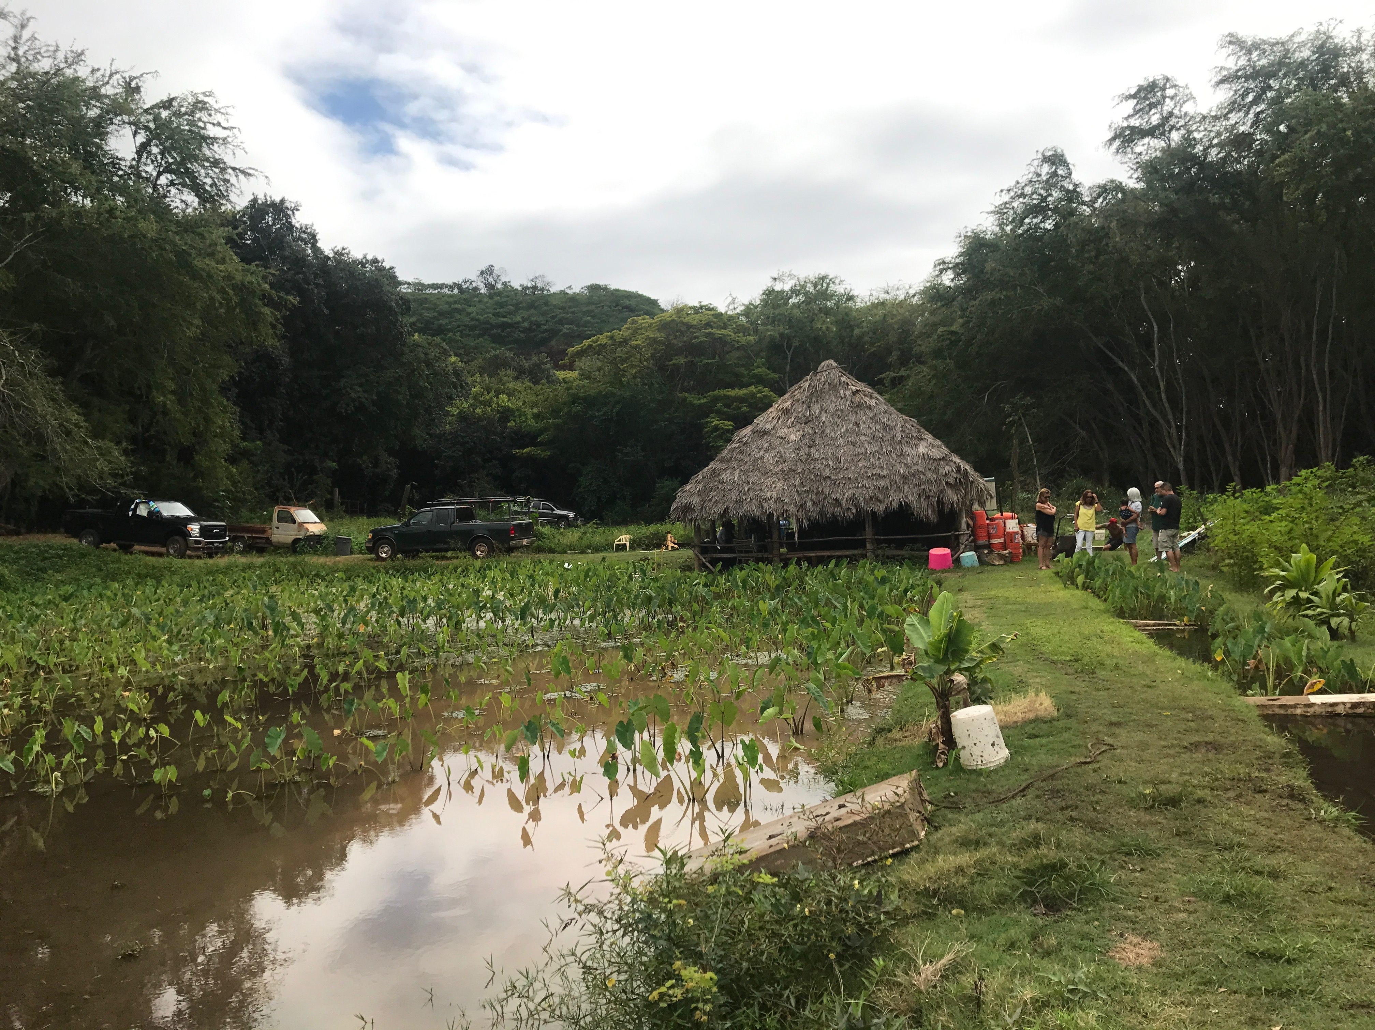
Implication for Research in Native Hawaiian Health
Consider impact of history on contemporary health issues and health care needs
Need to develop models of intervention and service that supports traditional values and beliefs
Capacity building within Native Hawaiian communities
Collaboration with health systems and creation of new systems
Notes:
Lessons learned from Native Hawaiians may also serve as a model for understanding the health concerns for other indigenous populations and racial and ethnic minority populations

Slide 13
Brief Biography
Fedele F. Fauri Collegiate Professor of Social Work, University of Michigan, 2011-present
Visiting Professor, Department of Native Hawaiian Health, John A. Burns School of Medicine, and Myron B. Thompson School of Social Work, University of Hawai’i at Mānoa, 2015-2017.
Associate Dean of Educational Programs, University of Michigan, 2010-2015.
Associate Professor, University of Michigan,2003-2011.
Assistant Professor, University of Michigan, 1997- Sept. 2003.
Postdoctoral Research Associate, National Institute of Mental Health Social Work Research Development Center on Poverty, Risk and Mental Health, University of Michigan, 1996-97.
Doctor of Philosophy, Social Welfare, University of Washington, Seattle, WA, 1996
Master of Science, Social Work, Administration and Planning, University of Texas, Austin, TX, 1992
Bachelor of Arts, Psychology, University of Hawai’i, Mānoa, HI, 1988

Slide 14
Previous Research
Community-based participatory research (CBPR) in Detroit, Michigan
African American and Latino communities
Culturally-tailored diabetes intervention using community health workers
Three cohorts since 2000, two randomized-controlled trials
Successfully demonstrated the effectiveness of the intervention
Developed policy action arm to sustain and institutionalize community health workers in Michigan

Slide 15
Other Research Interests
Discrimination and Physical and Mental Health and Service Utilization among African Americans, Latinos, and Asian Americans
Anti-bigotry Education
Multicultural Practice in Social Work
Health Equity and Social Determinants of Health
Cultural Practices that Promote Health Equity
Over $14 million in funding for research projects

Slide 16
Teaching
Organizations, Communities, and Society
Human Differences, Social Relationships, Well-Being and Change Through the Life Course
Social Problems and Social Work in the 21st century (undergraduate course)
Diversity and Social Justice through Dialogue
Dialogue Facilitation
43 prelim exams, 49 dissertations
Diversity and Social Justice
Decolonizing Social Work
Community Development
Multicultural/Multilingual Community Organizing
Social Work Practice with Communities and Social Systems
Contemporary Cultures in the United States

Slide 17
Honors and Awards
Rosalie Ginsberg Outstanding Faculty Award for Community Service and Social Action, 2009
Committee on Institutional Cooperation (CIC) Academic Leadership Program (ALP) Fellow, 2008-2009
Harold R. Johnson Diversity Service Award, University of Michigan, 2003
Co-Chair, Grand Challenges for Social Work Health Equity Steering Committee, 2015-present
National Advisory Committee of the Fahs-Beck Fund for Research and Experimentation, 2016-present
NIH, Community Level Health Promotions (CLHP) Study Section, Charter Member, 2011-2015
American Academy of Social Work and Social Welfare (AASWSW), Elected Fellow, 2016
Council on Social Work Education (CSWE) Carl A. Scott Memoral Lecturer for Equity and Social Justice, 2014
Fellow of the Society for Social Work Research, Inaugural Class of Inductees, 2013
Society for Social Work Research (SSWR) Board Member at Large, Elected 2009-2011
Honorary Lavender Degree, University of Michigan, 2010

Slide 18
Current Research:
Native Hawaiian Well-being through the Integration of Cultural Practices that Promote Health
Integration of Native Hawaiian Healing into Primary Care
Use of Aquaponics to Promote Ahupua’a (regional community) Health
Pono Research Practices

Slide 19
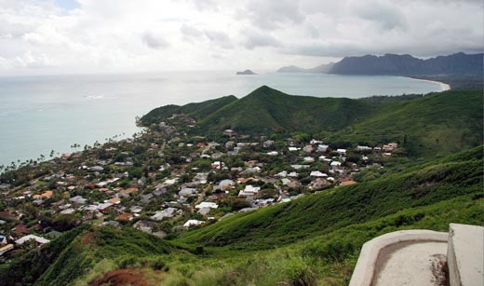
Integration of Native Hawaiian Healing into Primary Care
Waimanalo, eastside island of Oahu, rural, large NH homestead land
Approximately 25% Native Hawaiian (pop. 3664, 2000 census)
Home of the Waimanalo Health Center, a federally qualified health center
Strong sense of NH identity and grassroots organizing
Increasing tourism, home of the Bellows Air Force base

Slide 20
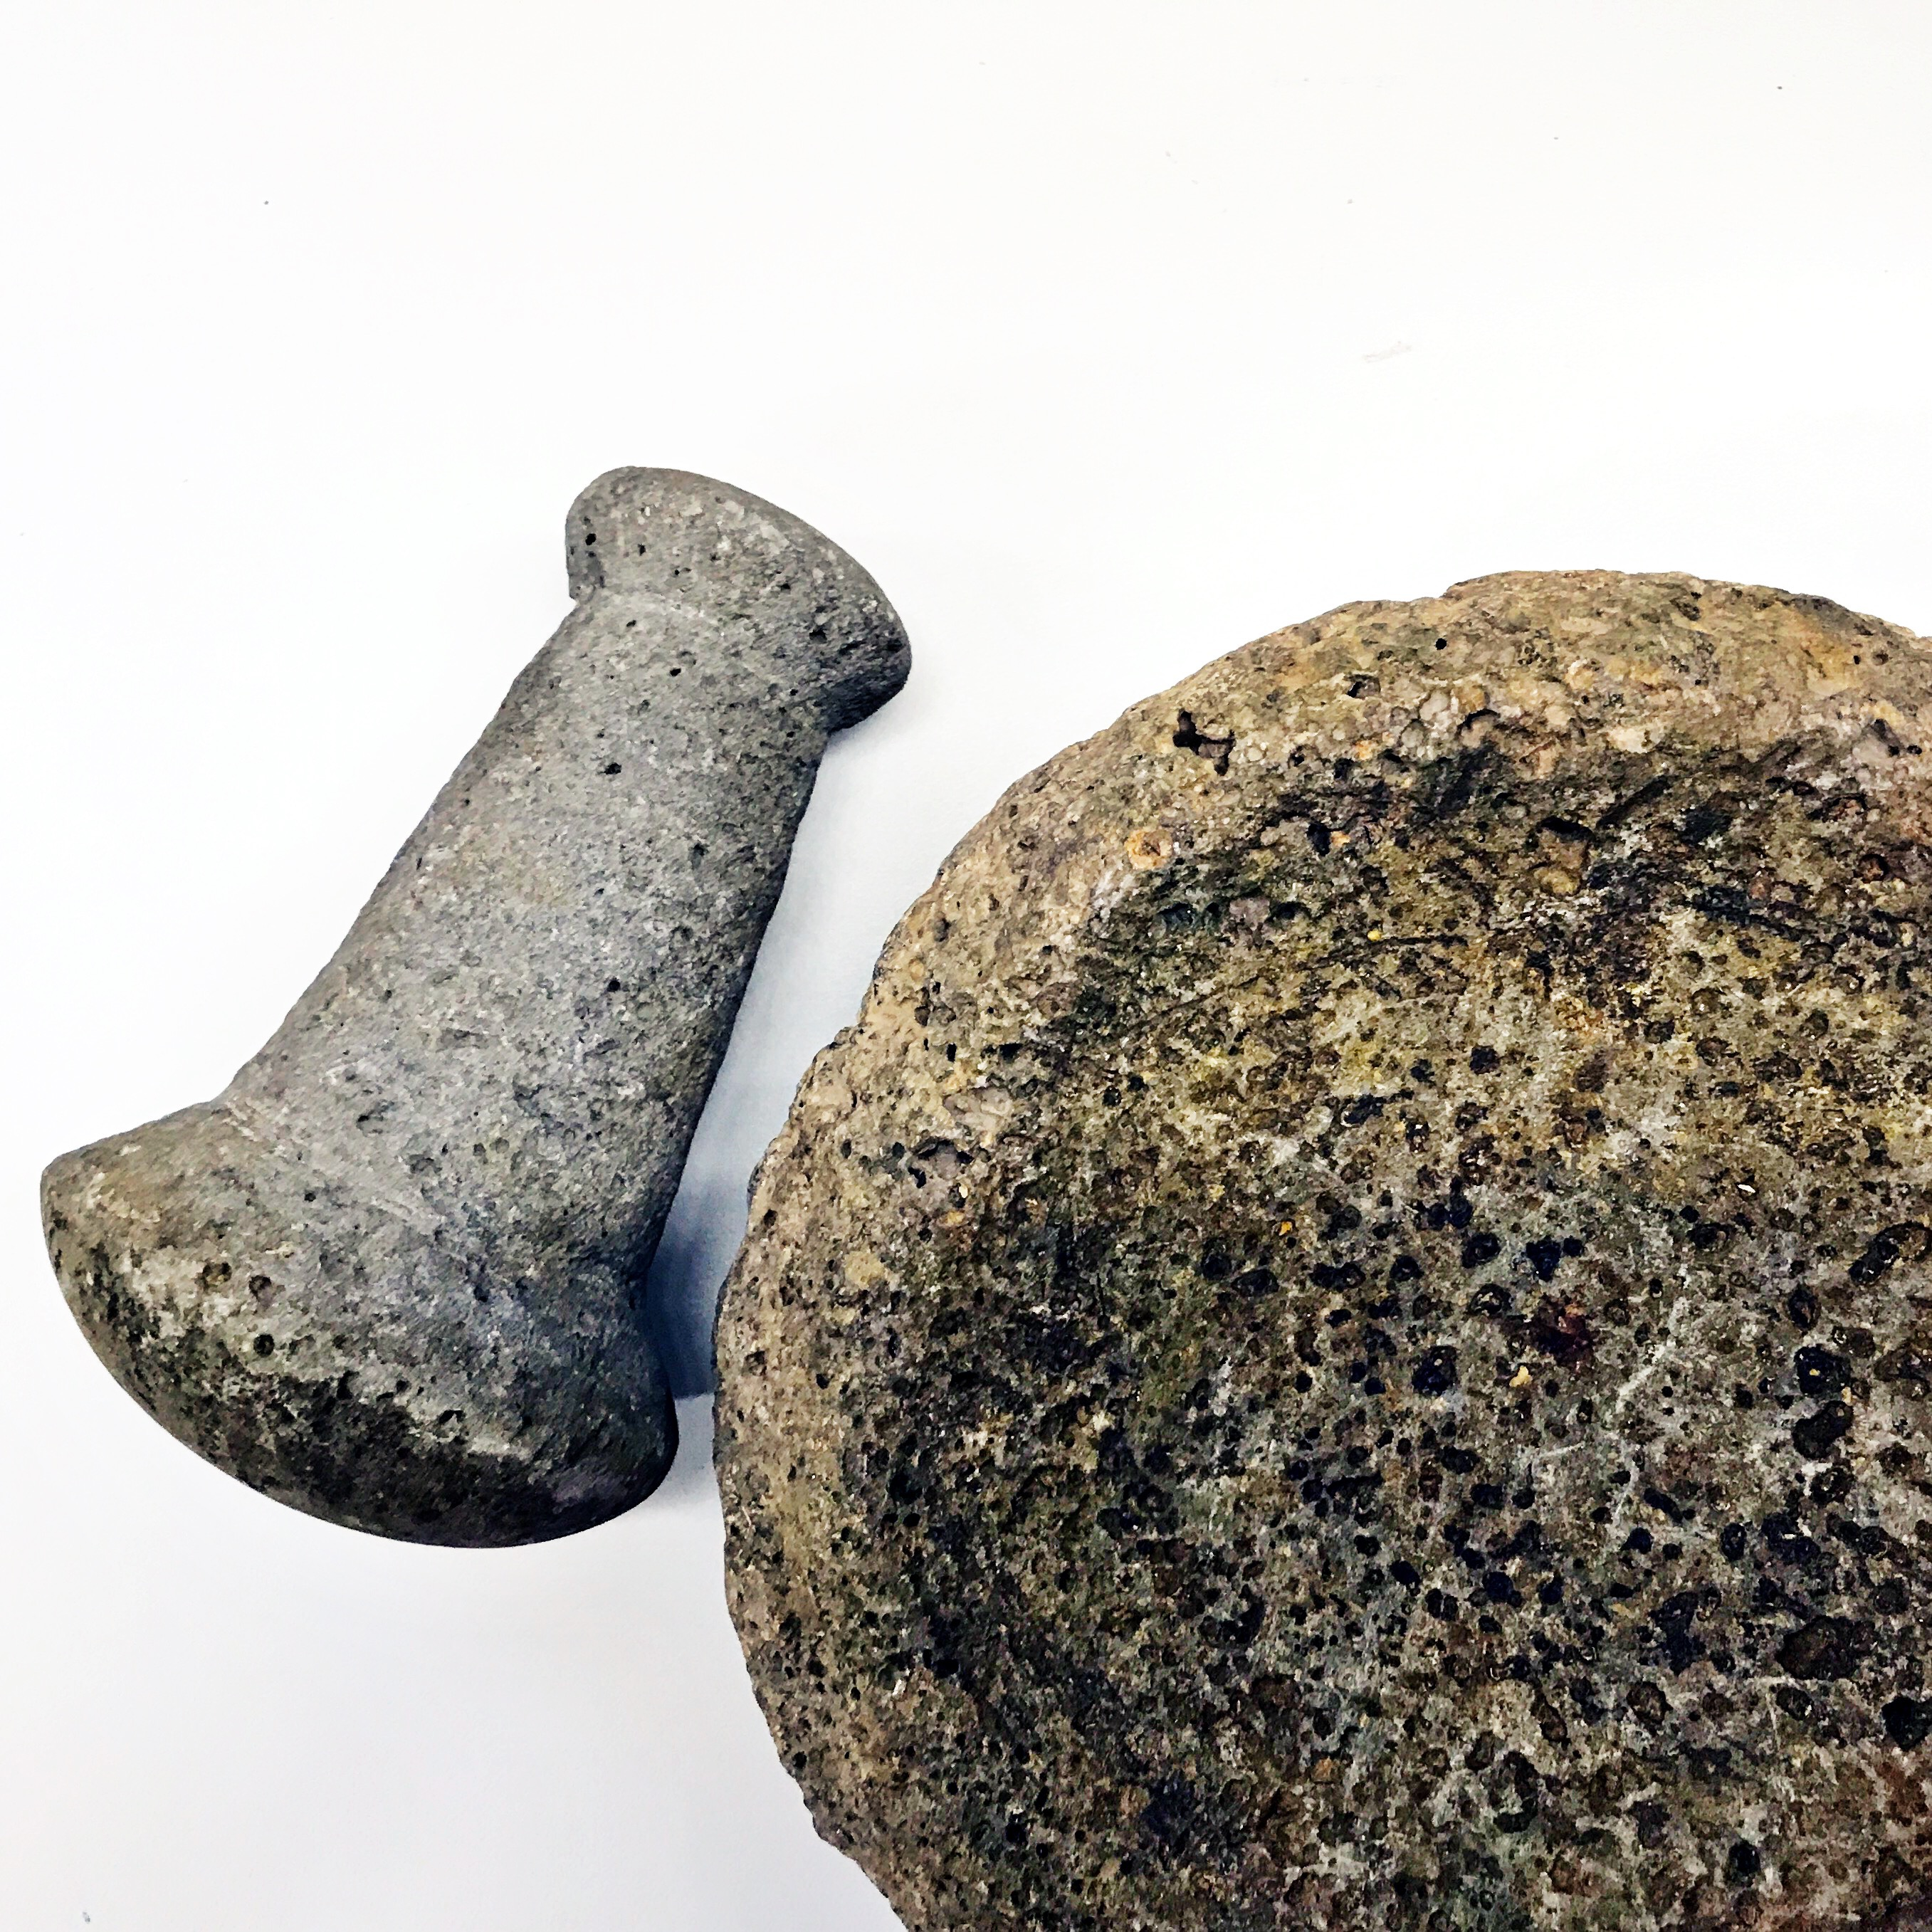
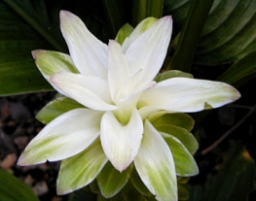
Native Hawaiian
Healing Practices
Native Hawaiian healing practices were integral to the health of NH (kānaka ‘ōiwi) prior to the western colonization: body, mind and spirit
These practices were carefully passed down through generations as sacred wisdom
Though its practice was previously limited due to western influences, there is a growing revitalization and proliferation in use, e.g., lā‘au lapa‘au, lomi
Increasingly, these practices are included in promoting health and healing in medical services for kānaka ‘ōiwi, including its integration at Waimānalo Health Center

Slide 21
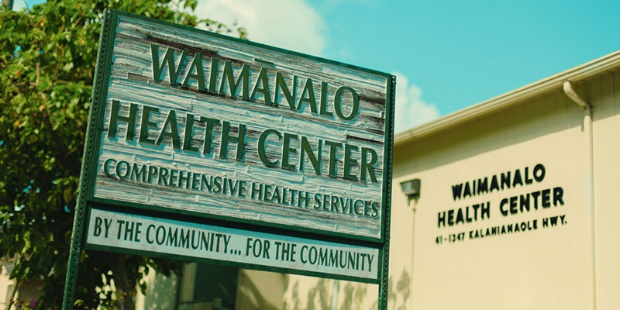
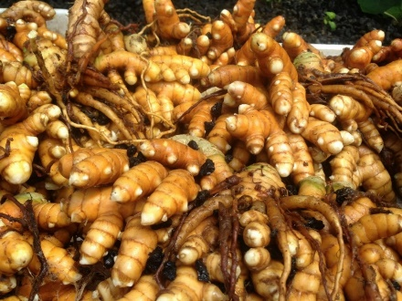
Purpose
This study examines one model for the integration of Native Hawaiian healing practices into primary care
Our goal is to understand the added value of integrating Hawaiian healing for improving the patient experience and promoting the health and well being of kānaka ‘ōiwi
We will begin by examining a theoretical framework of how integration improves patient experiences and outcomes.

Slide 22
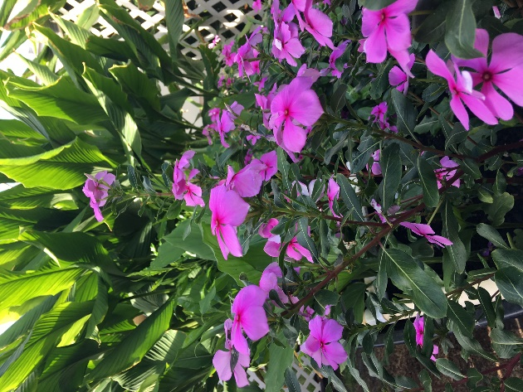
How Does Integration
Promote Health?
Integration
Acceptance
Cultural Connectedness
Activation / Empowerment

Slide 23
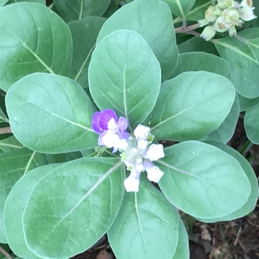
Integration at Waimānalo
Kānaka ‘ōiwi patients visit with western and Native healer together, not through a referral
All kānaka ‘ōiwi have access to a Native healer and information on healing practices, including treatment and classes
Healers are viewed as members of the health care team

Slide 24
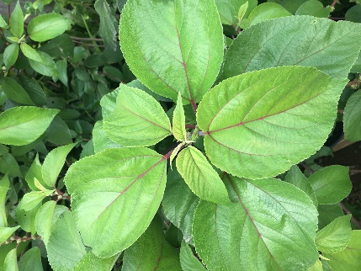
Acceptance
Through integration, there will be greater acceptance of native healing practices by:
    Patients
    Providers
    Staff and administration
    Community
Do these stakeholders see an added value?

Slide 25
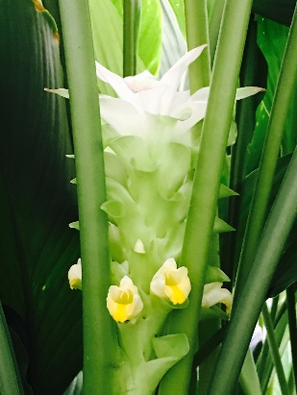
Cultural Connectedness
Is there a deeper sense of cultural connectedness as a result of integration and acceptance?
    Do patients feel more connected to providers and the clinic?
    Do patients, providers, staff and administration have a greater sense of connectedness to Hawaiian values and practices?
    Is the clinic viewed as more connected to Hawaiian values and practices by the community and kānaka ‘ōiwi statewide?

Slide 26
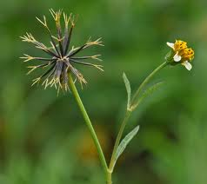
Activation/Empowerment
Does acceptability of integration and cultural connectedness lead to greater activation and sense of empowerment among patients, providers, administration and staff?
    Do patients feel like they have a greater sense of control over their health and adherence to treatment?
    Do providers, staff and admin promote integration and value healer’s contributions as members of the team
    Is there a diffusion of healing practices within the community, e.g., growing gardens, sharing remedies, etc?

Slide 27
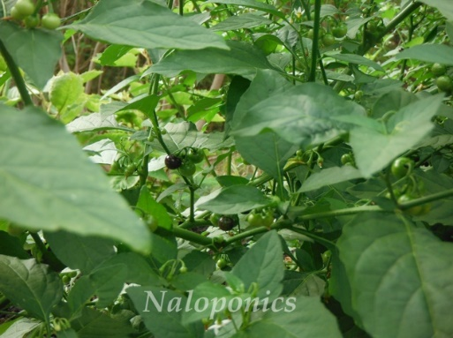
Promotion of Health
If kānaka ‘ōiwi find the integration valuable, increase their connectedness to their cultural values and their medical services, increase their sense of control over their health, and improve health behaviors…
This will lead to improved health outcomes and may be particularly useful for improving chronic disease outcomes, e.g., diabetes, CVD

Slide 28
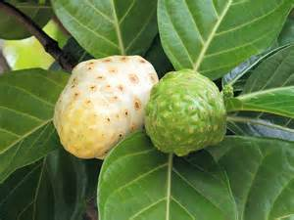
How Will We Accomplish
This?
Community-based Participatory Research (CBPR)
    Views research as a equal and collaborative partnership between community members, organizations, and researchers
    Involves community in all aspects of research process
    Builds on strengths, resources, and expertise within the community
    Shared decision making and ownership
    Strives for action and mutual benefit of all partners
    Disseminate findings to all partners and community

Slide 29
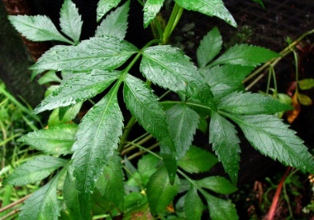
Three Phase Process
Phase 1
    Understand the process of integration and the critical components the healer adds, which might be missing in western medical practices
    Qualitative, in-depth interviews with patients, providers, including healer, staff, administration
    The goal is to confirm/disconfirm or add to the theoretical model defined by our group

Slide 30
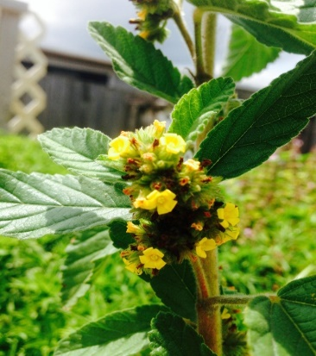
Three Phase Process
Phase 2
    Systematically test our theoretical model through surveys with patients
    Pre-post questionnaire to examine changes in acceptance, connectedness, activation and empowerment
Phase 3
    More rigorous study to examine whether integration leads to improvements in health outcomes, social determinants, increased medicinal plant growth, etc.
    Potentially use a culturally-rooted curriculum and comparison group, possibly extend work beyond Waimānalo Health Center to the community

Slide 31
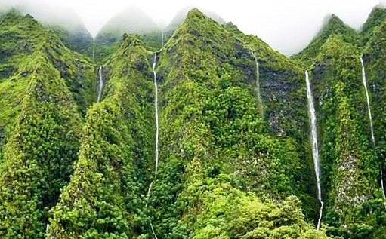
Next steps
Continue to engage Community Advisory Board in the following:
    Revise research plan as needed
    Develop and refine research questions
    Prepare additional proposals for funding, Phase 1 funded by Hawaii Medical Health Services Association (HMSA), $181,011
    Begin Phase 1 while continuing to plan for Phase 2 and 3
    Complete protocols, IRB, hire staff, begin interviews

Slide 32
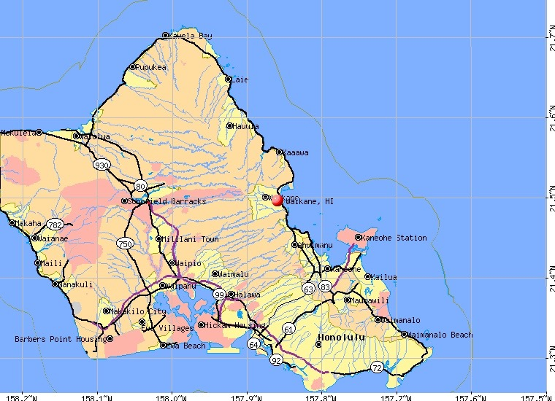
Why is the integration of cultural practices in intervention research useful?

Slide 33
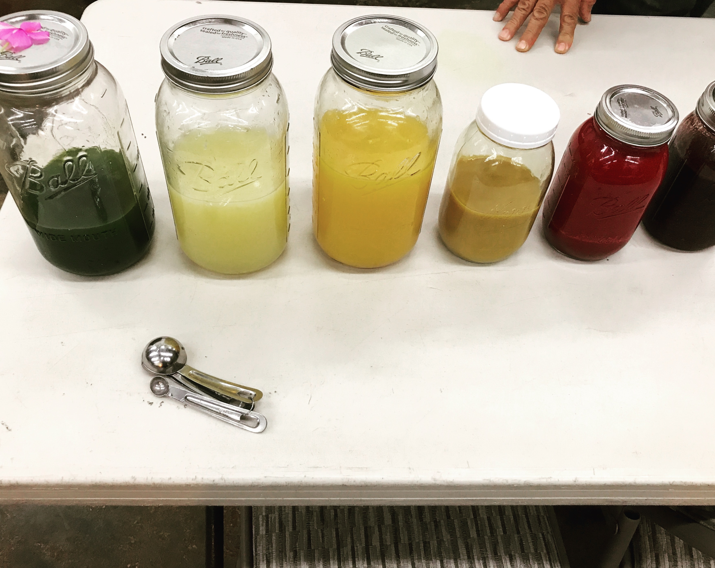
Native Hawaiian Values for Culturally-rooted Research
‘Ea (self-determination)
‘Aina Moana (health of land and people)
Pilina (relationships, connection)
Waiwai (ancestral abundance, wealth, benefits)
‘Oiwi (intergenerational cultural identity)
Ke Akua Mana (spirituality, sacredness, divinely powerful)

Slide 34
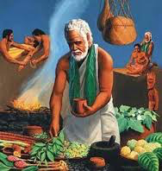
Preliminary Observations
Patients enjoy learning about healing practices
-Reminds them that these practices were used by parents/grandparents
-Validates that parents/grandparents had important knowledge/wisdom
-Strengthens their identity as Native Hawaiians
-Finding success with healing practices and want to learn more
-Desire to get off of western medications
-Desire to share these practices with family, children, friends
Challenges
-Access to the plants
-Not remembering what the plants looked like and what they did

Slide 35
Preliminary Observations
Providers respect healing practices
-Do not have formal knowledge/training
-Want to be supportive, willing to work with patients who want to try
-Make no claims of evidence, except where it exists, e.g., turmeric (olena)
-See their role as monitoring clinical outcomes and adjusting medications
Community
-Growing recognition and adoption of healing practices
-See this as part of a larger effort toward self-determination and social justice
-See this as a way of promoting community and cultural identity
-Way to respect the knowledge of the elders/kupuna in community
-Conflict among practitioners, what is their genealogy?

Slide 36
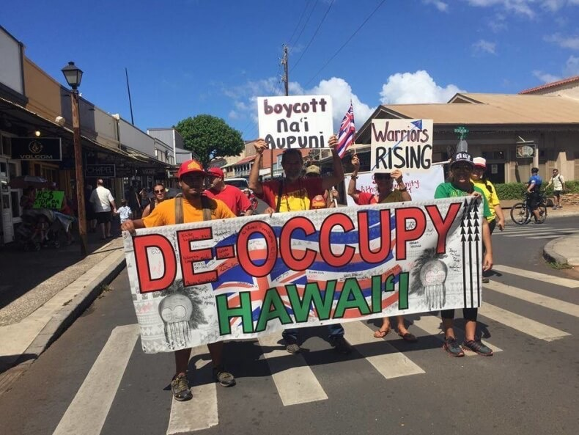
Conclusion
The image of Hawaii as a “must see” tourist destination is so overpowering that the truth of the condition of Native Hawaiian people are met with disbelief and anger.
Problems will be resolved through our own awareness, education, and social action
Native Hawaiians are a resilient people, survivors of plague,
pestilence, diaspora, and cultural genocide
We must assure that history does not repeat itself.

Slide 37
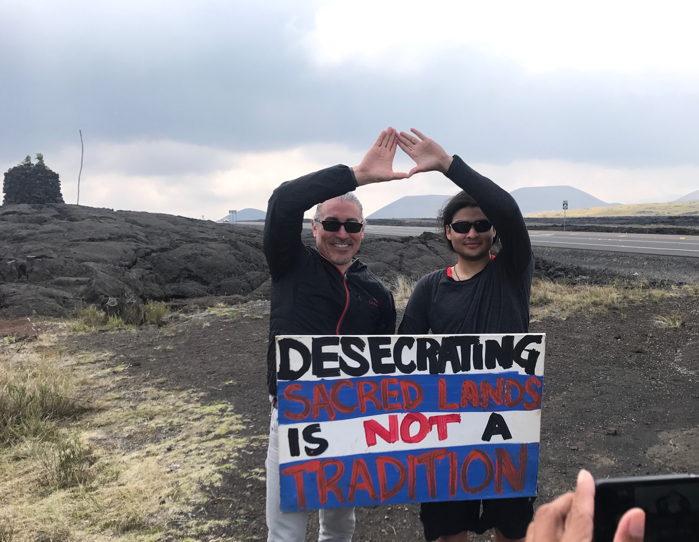
Mahalo!
Nānā no a ka lā‘au ku ho‘okāhi.- look for the plant that stands alone. It was said if a plant stood alone, it would be better and stronger for use in healing.
(Kawena Pukui,‘Ōlelo No‘eau 2270)
Momoe aku I mua
Move forward with determination!

